Slide 1


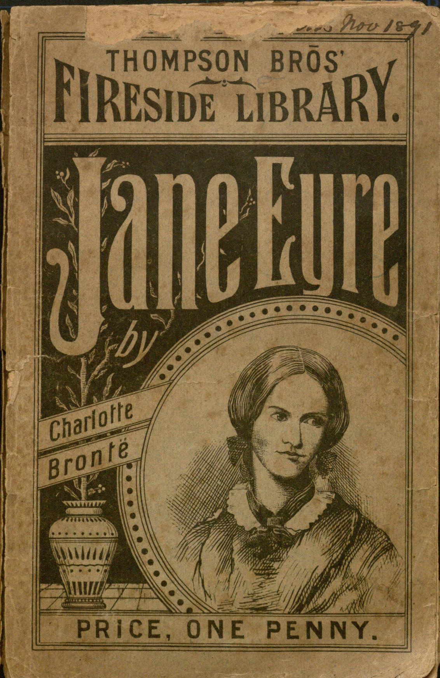

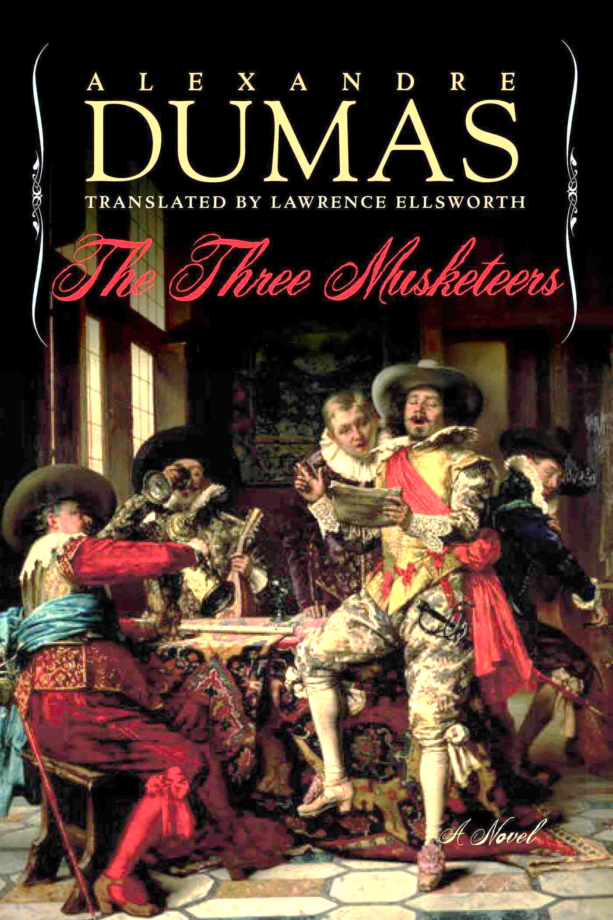
Is this Book a Classic?
By Bryan Pritsker

Slide 2

Investigation
What does it mean when a book is considered a classic novel? Are these books of a certain time period? Are classic novels of a specific genre?
The goal of this analysis is to not only uncover the characteristics that make up “classic” novels, but to be able to distinguish and predict classic books from other types of literature.

Slide 3



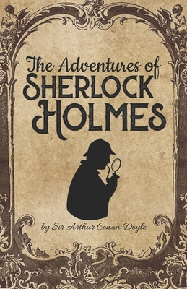

Hypothesis
A book will be tagged a classic novel if it is at least 50 years old, has a rating of at least a 4.5/5, and is part of the historical fiction, mystery, romance, adventure, or any similar type of genre. Since fantasy and science fiction novels are more modern genres, they will not be considered classic books as often in the dataset.

Slide 4
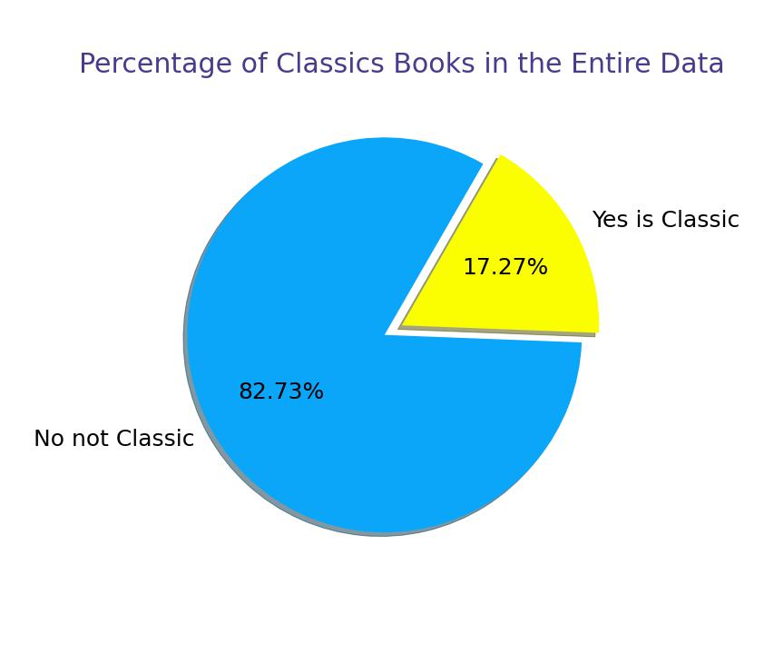
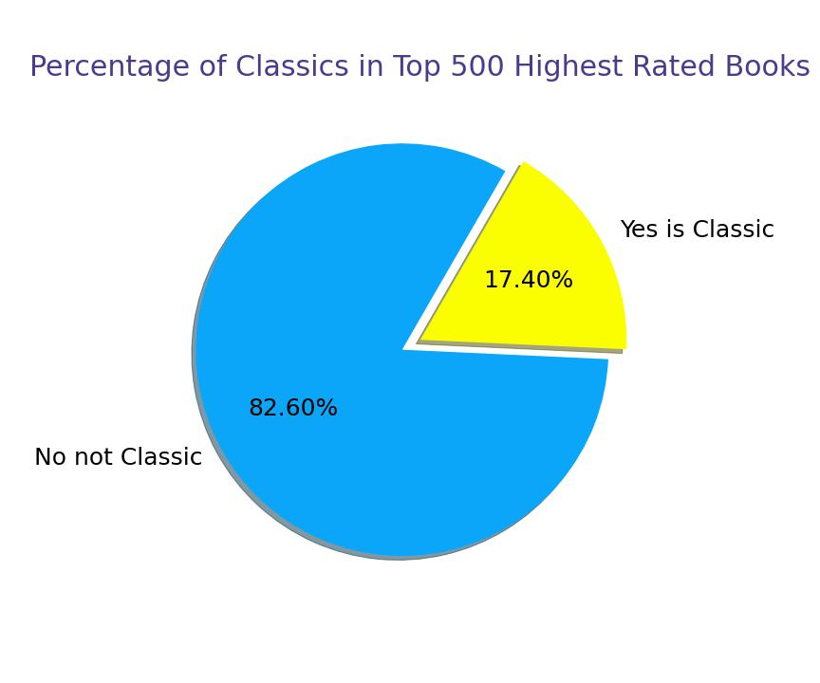
Percentage of Classic Books

Slide 5
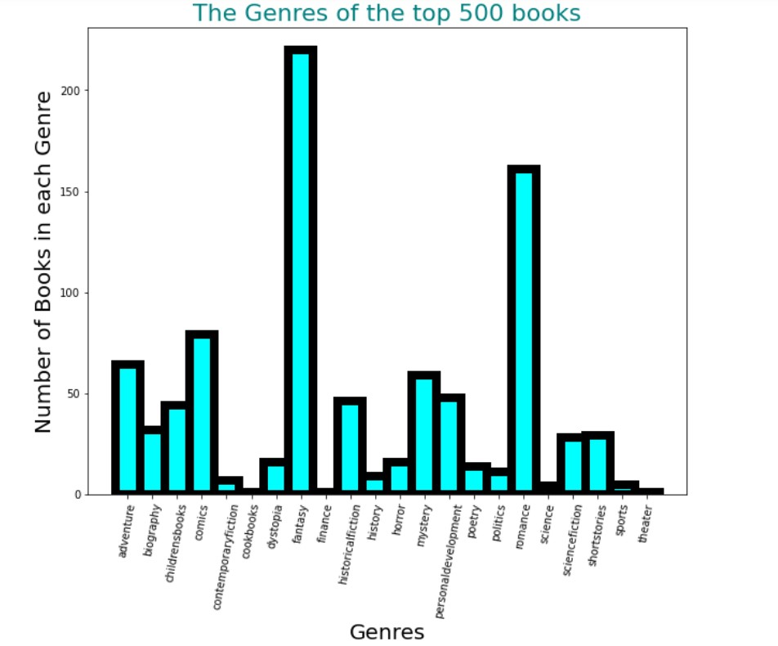
What the data shows
Out of the 500 best rated books in my data set, the fantasy genre has the most books with the highest average rating.
Thus, if classic books are “supposed” to have high ratings, then this means that most classic books should fall under the Fantasy genre.

Slide 6
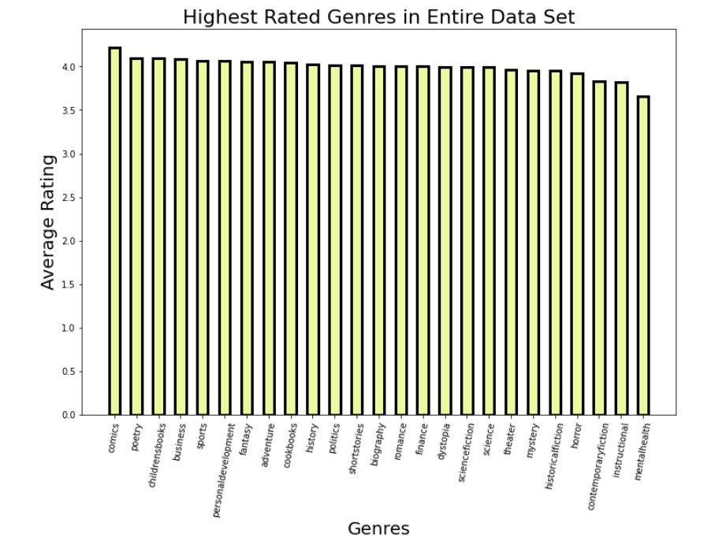
Analysis
Surprisingly, the highest rated genre on average is comic books!
Certainly, comic books will not be considered classics.
There are only 367 comic books in the entire data set.
However, in this graph the fantasy genre makes the top 7 highest rated genres. In comparison with comic books, there are 2,844 fantasy books in the data! That means that nearly 30% of all the books are fantasy books.
In contrast to our hypothesis, it looks like classic novels will not fall under a few specific genres.
Also… it is likely that classic books won’t be rated much higher than other books.

Slide 7
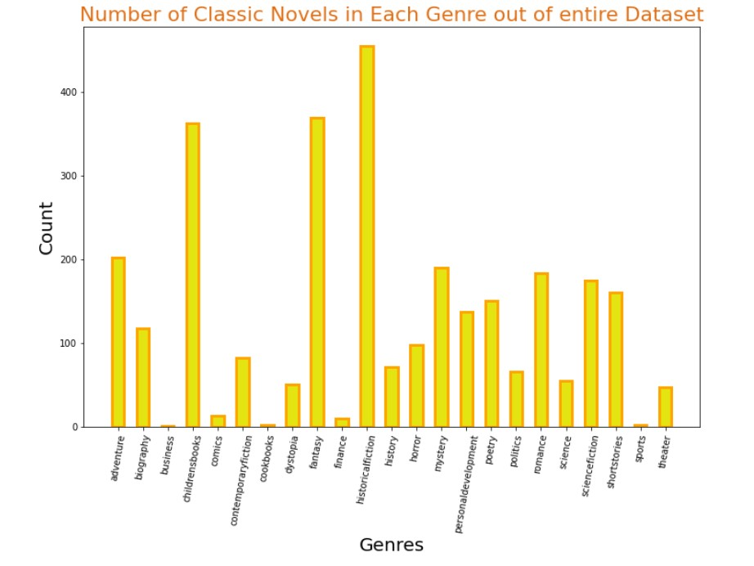
Analysis
Many classic books fall under the fantasy genre.
However, most classic novels tend to be historical fiction, romance, adventure, and children's’ books.
So, this graph both supports and slightly counters our hypothesis

Slide 8
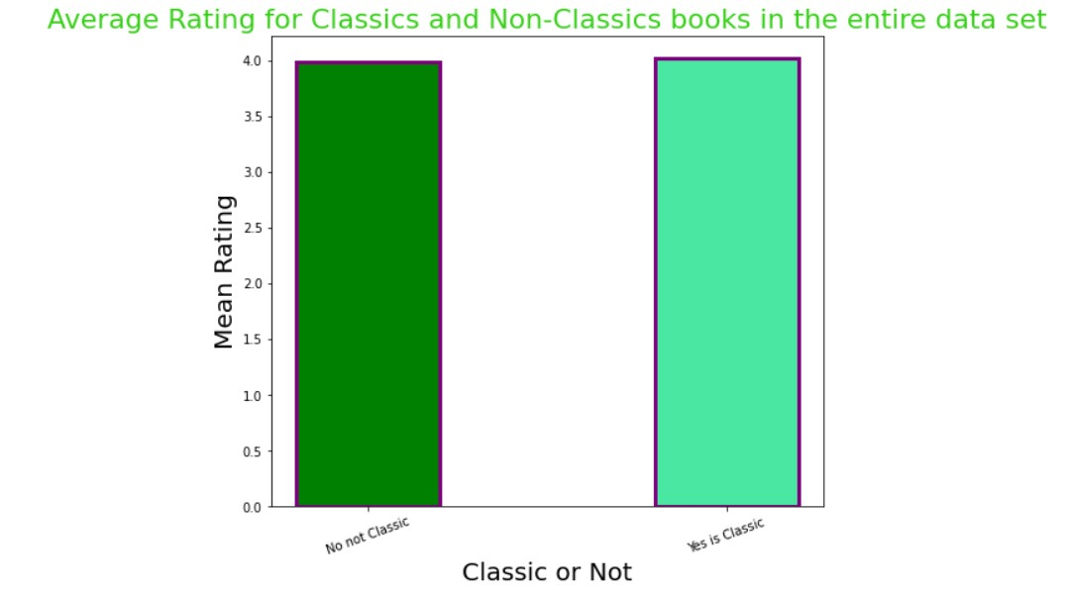
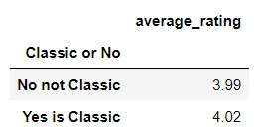
Are Classic Novels Really Rated Higher?

Slide 9
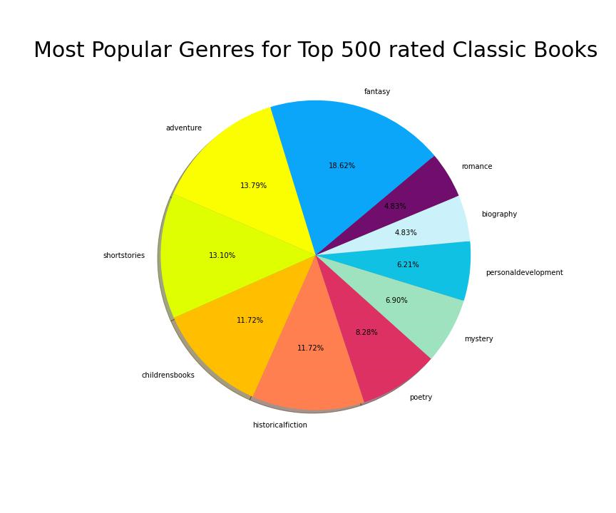
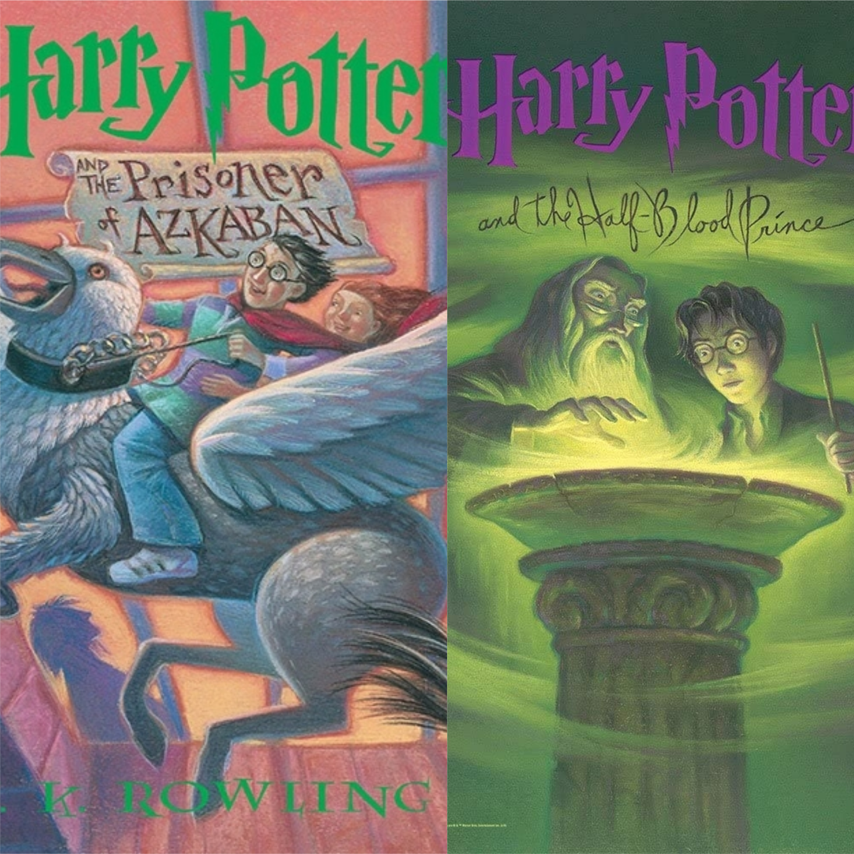
Highest Rated Classic Books
The highest rated classic books do not fall in one specific category. There is a lot of diversity to the genres that make up classic novels!

Slide 10
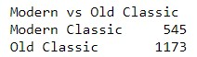
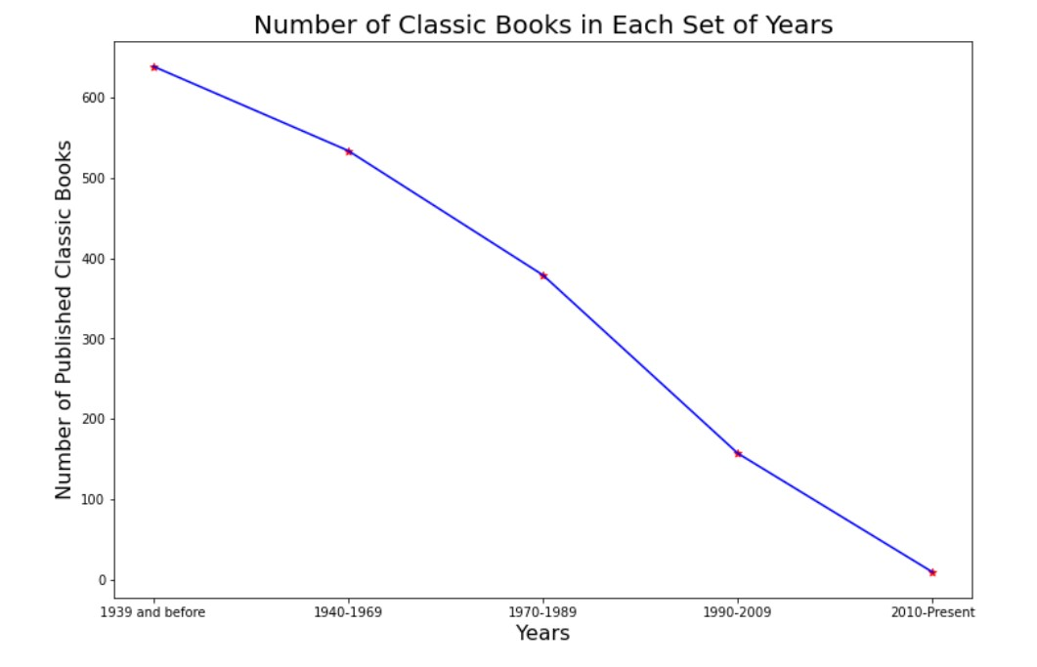
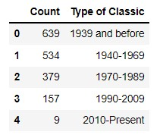
What About Year of Publication?
Year of Publication
Modern Classics: 1970- Present
Old Classics: Before 1970

Slide 11
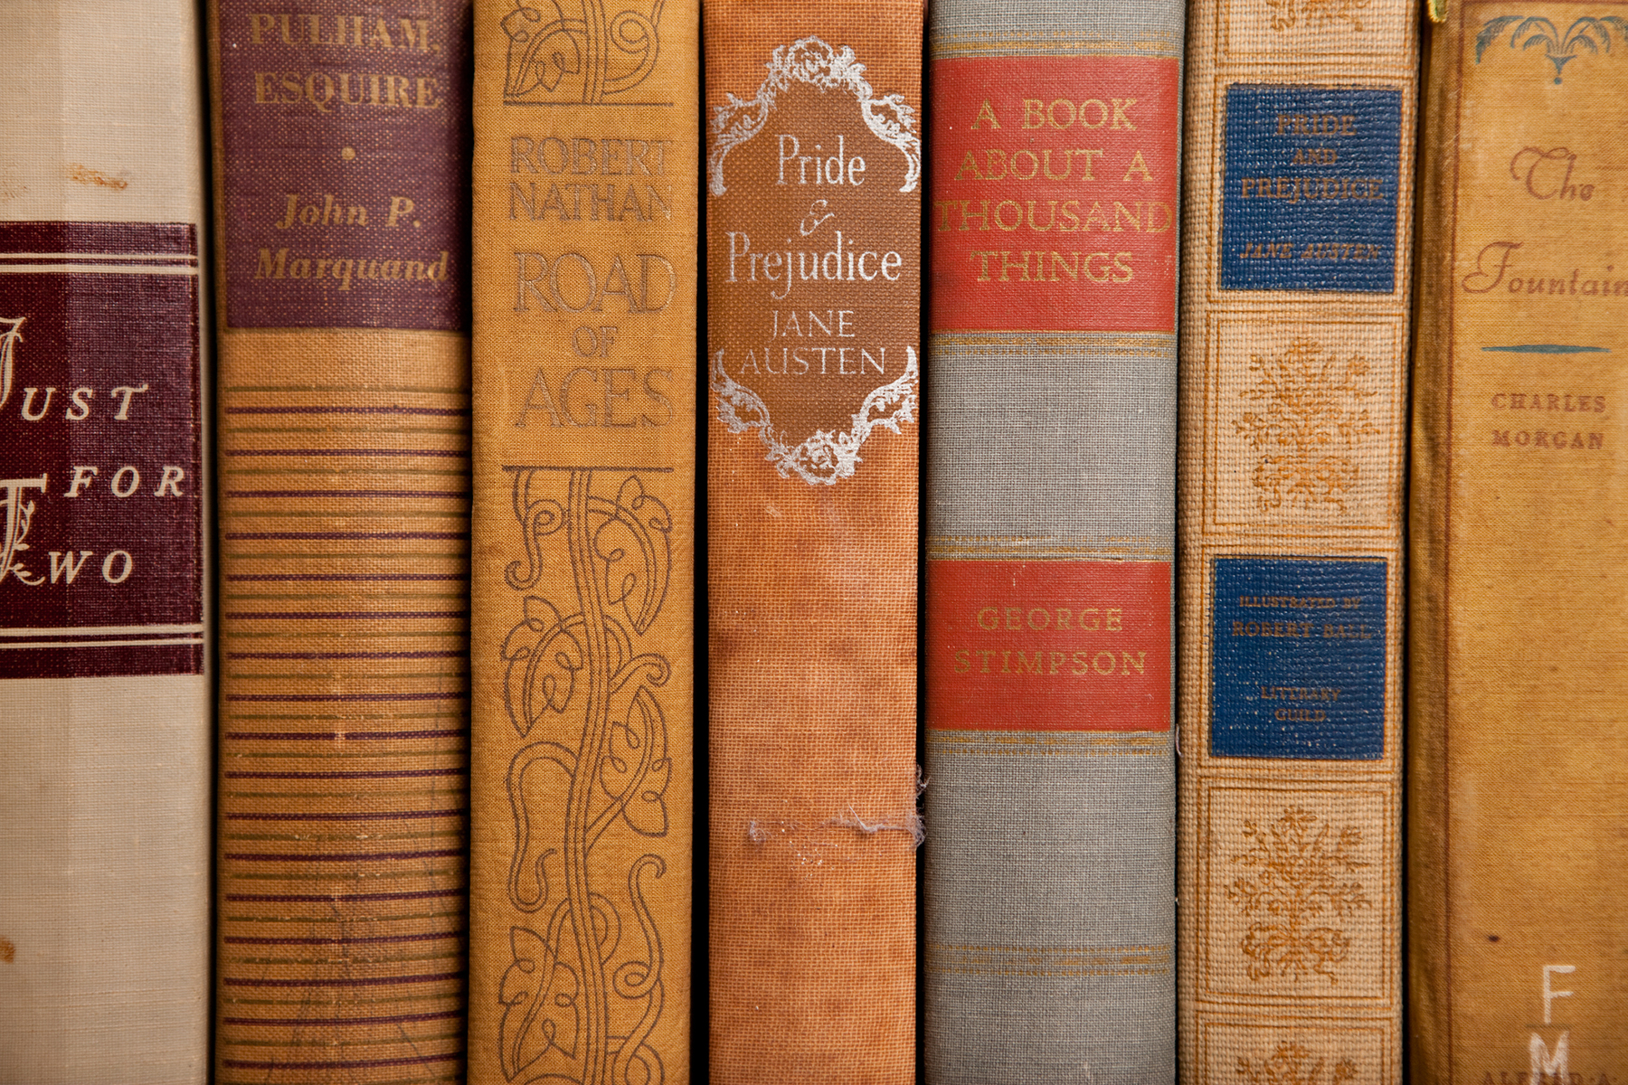

Analysis
The year of publication certainly affects whether if a book will be rated a classic or not.
Books that were published 50 years ago are only now being reviewed as “classic” novels.
Whereas books that were published 10 years ago have not been given enough time to be called “classic”.
The majority of classic books have been published before 1940.
In the data set, the youngest classic novel was published in 2015.

Slide 12
Can we predict if a book will be classified as a classic?
Yes, our analysis confirms that this is still possible. By using Logistic Regression, we can accurately evaluate whether a book will be a classic or not.
Judging by our data, our independent variables should be:
1) The historical fiction, fantasy, adventure, children’s books, and romance genres, since these were the most common genres for classic books
2) The date of publication
3) The average rating. (Even though there isn’t a huge discrepancy between the rating of classic books and non-classic books, classic books still got the edge in this department, especially in certain genres, like historical fiction)

Slide 13
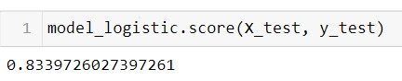
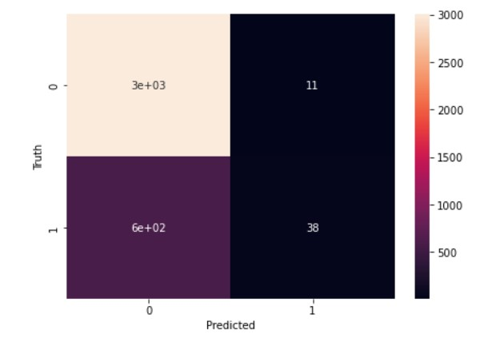
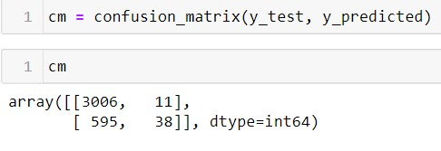
By setting our test size = 0.2, these were the results:
Predicted Classic books with 83% accuracy

Slide 14

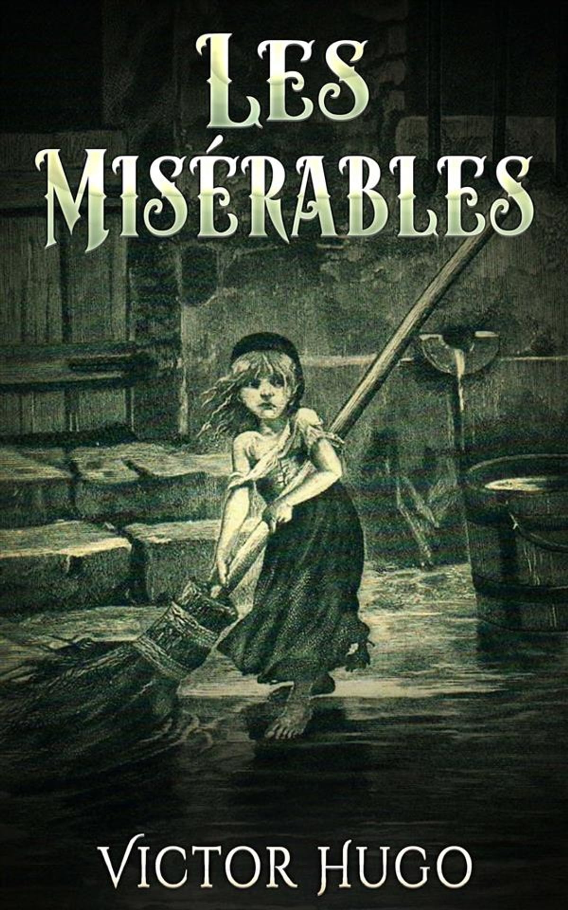
Conclusion
Books are not randomly selected to be “classics”.
A novel that was tagged as a classic depended on a few major factors before it was selected for this category.
These factors include: the year the book was published (how much time has passed for a re-evaluation and review of the book), the genre of the book (certain genres fit the “classics” criteria better than others, even though the analysis proved that a classic novel could be any genre at this point), and the average rating of the novel (yet this is the least effective independent variable.
Finally, according to the logistic regression model and the heat map, it is easier to confirm that a book is a classic, as opposed to deciding if a more modern, non-classic book should be considered a classic novel.

Slide 15
Source Used: “Goodreads-books” data set from Kaggle

